Slide 1
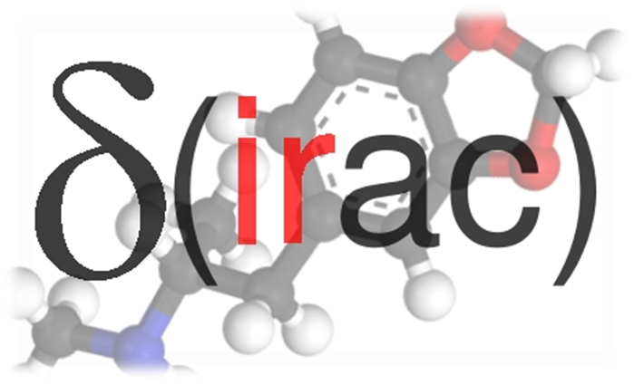
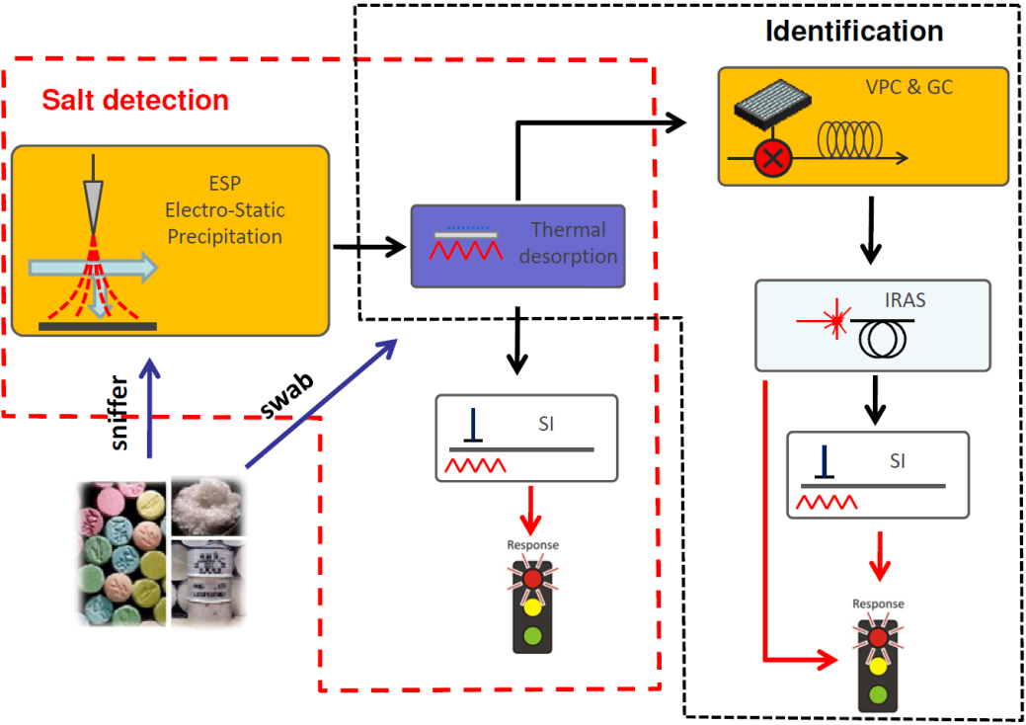
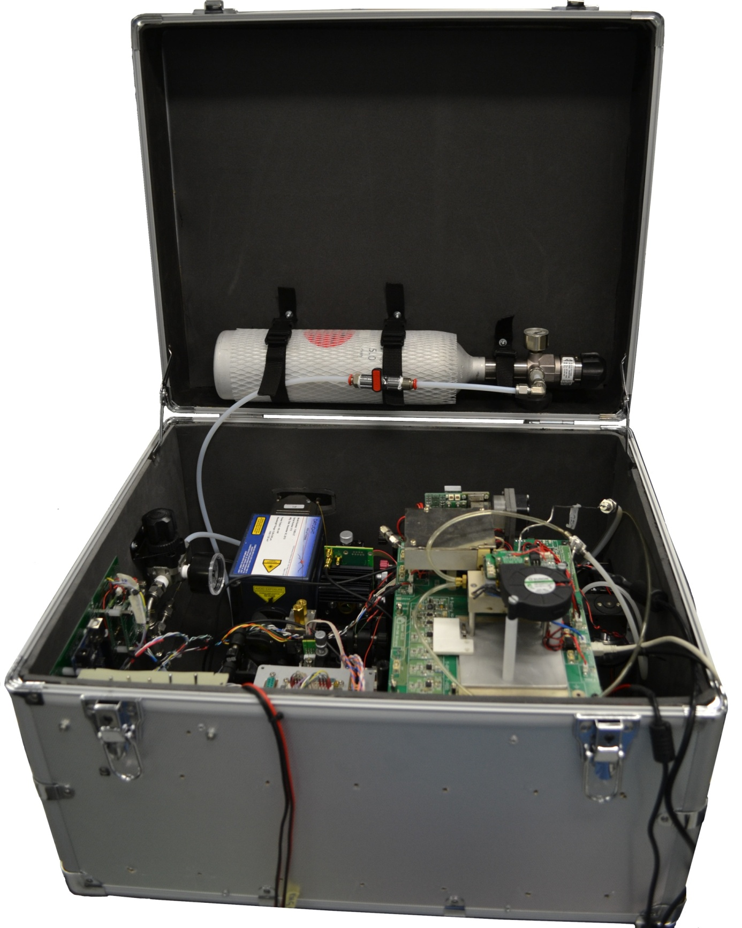
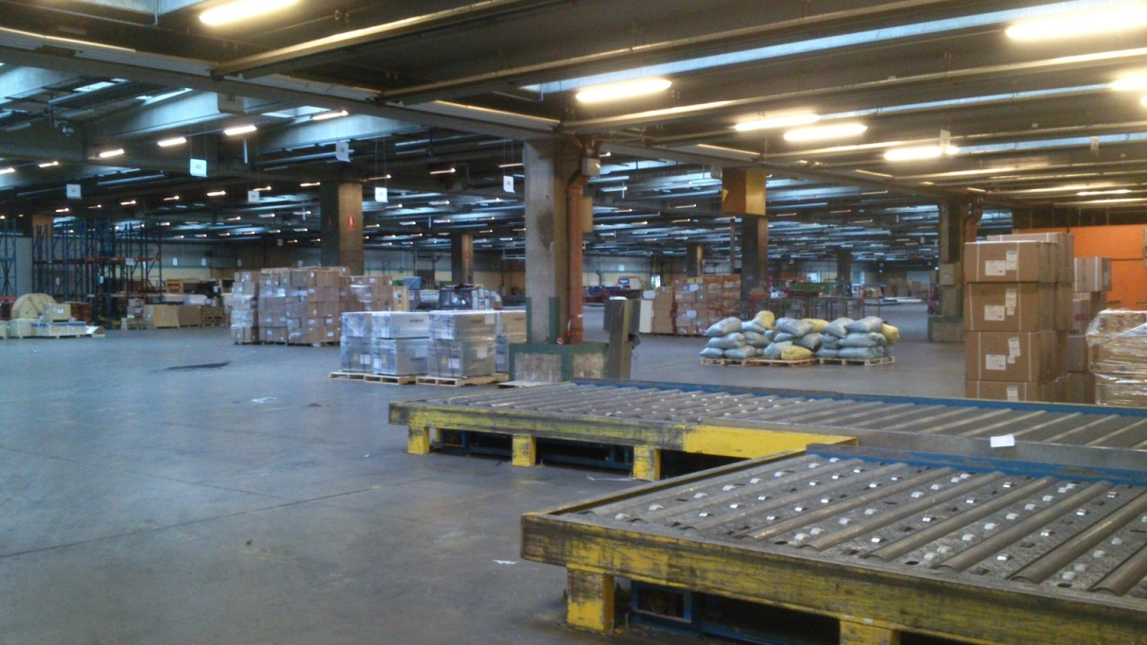
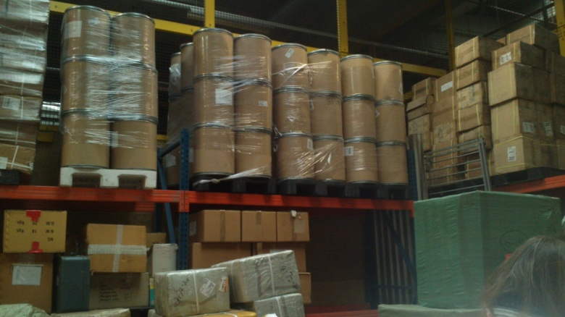
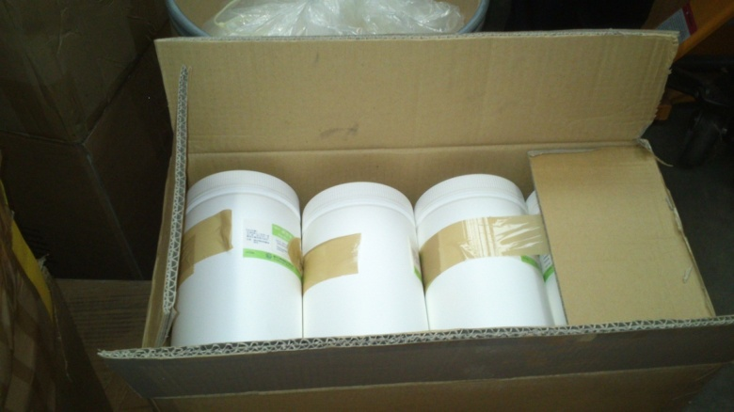
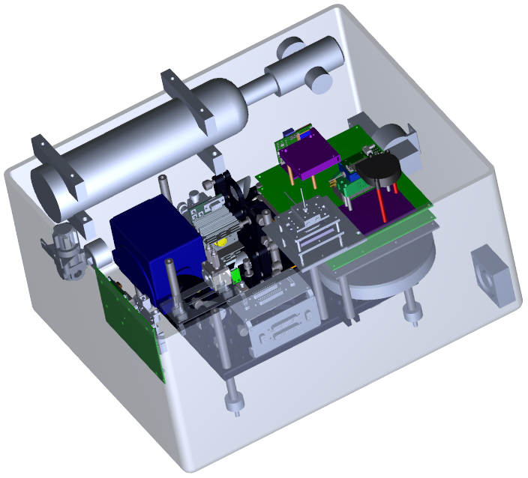
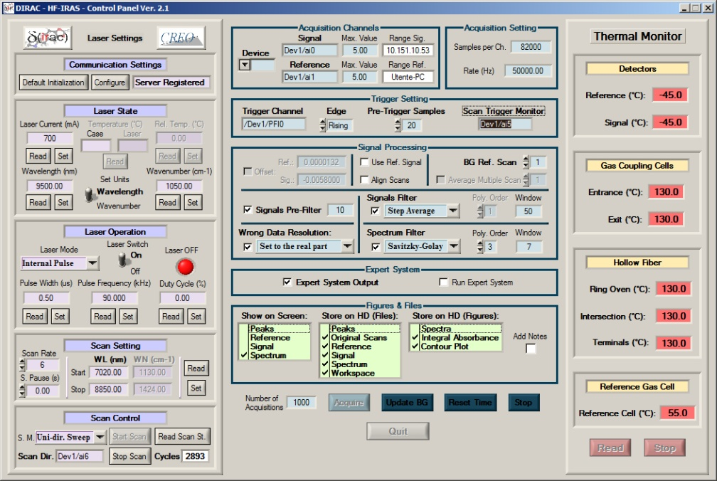
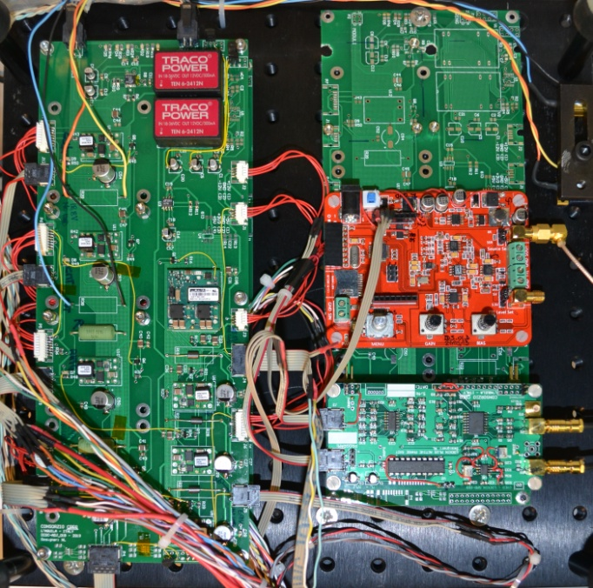
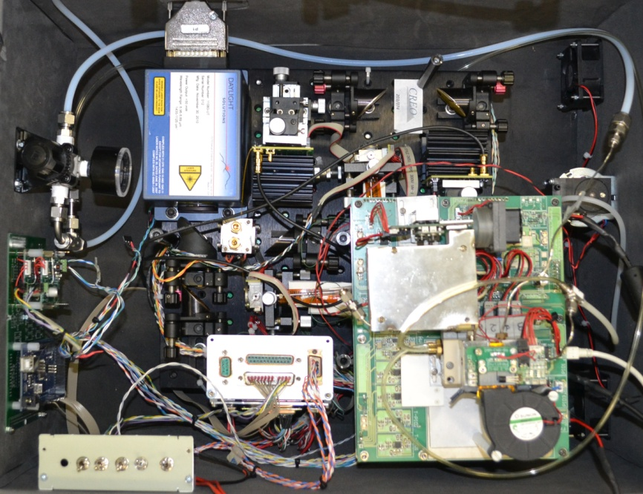
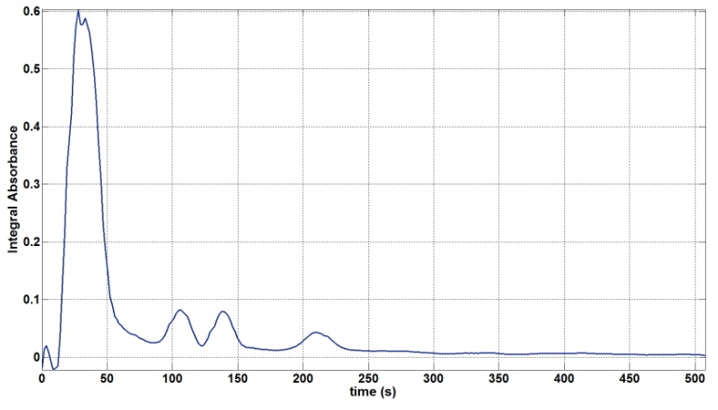
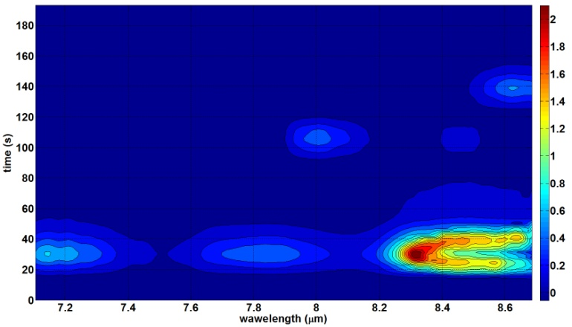
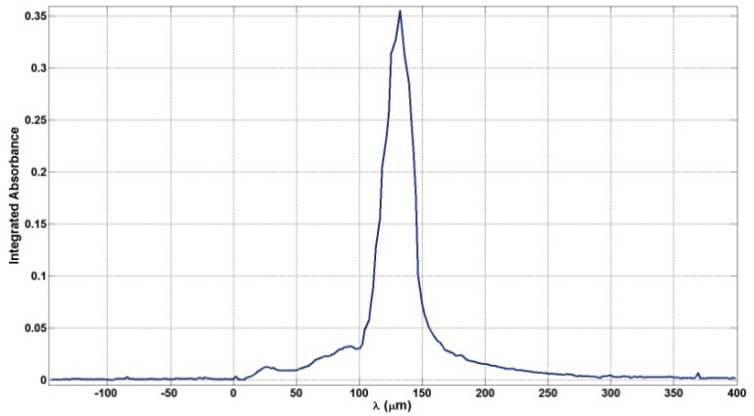
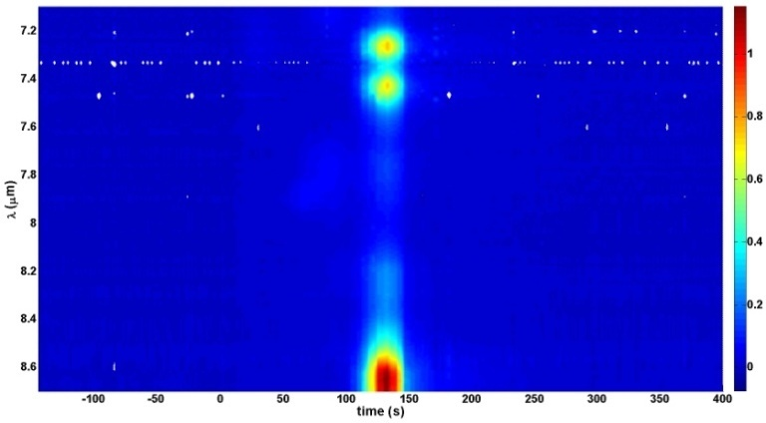
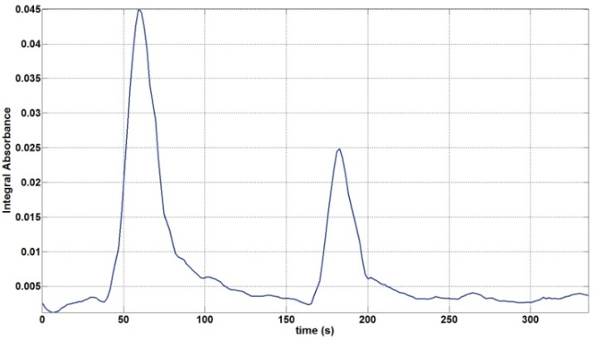
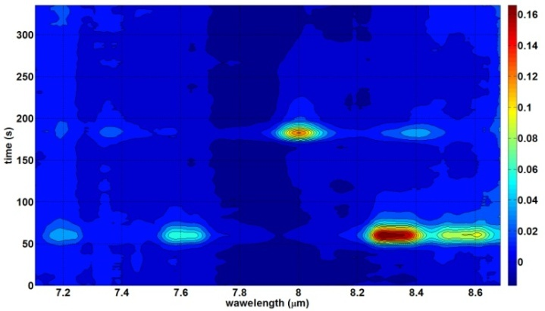
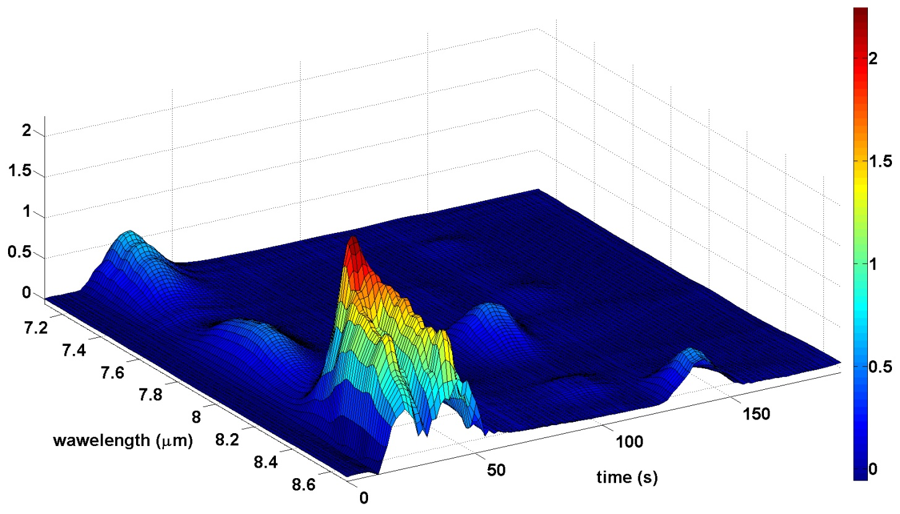
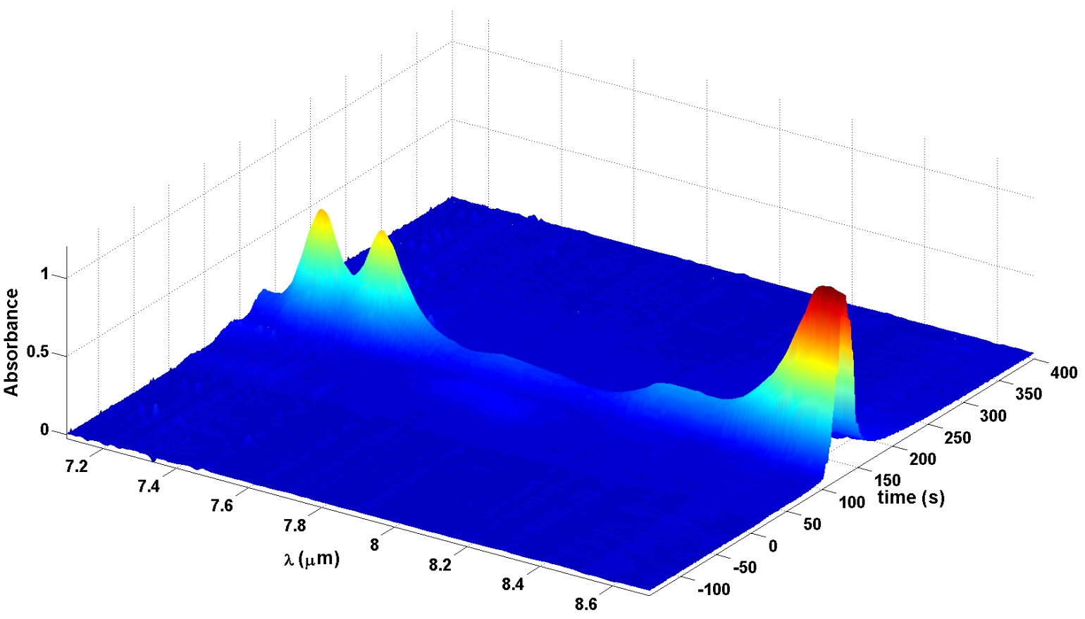
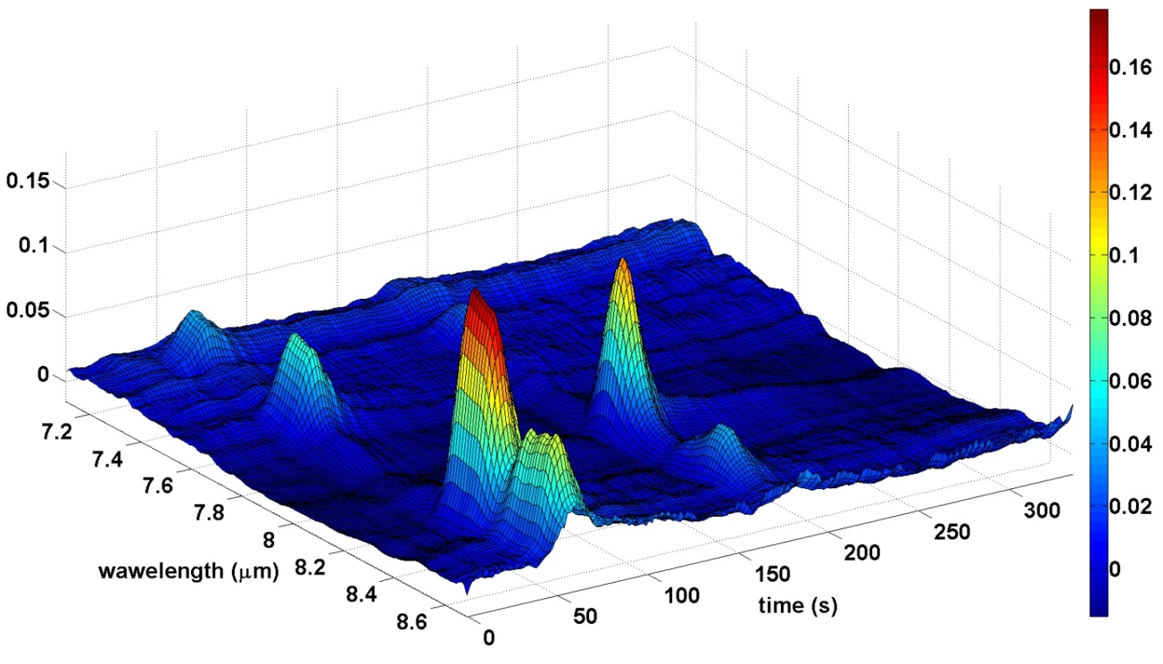
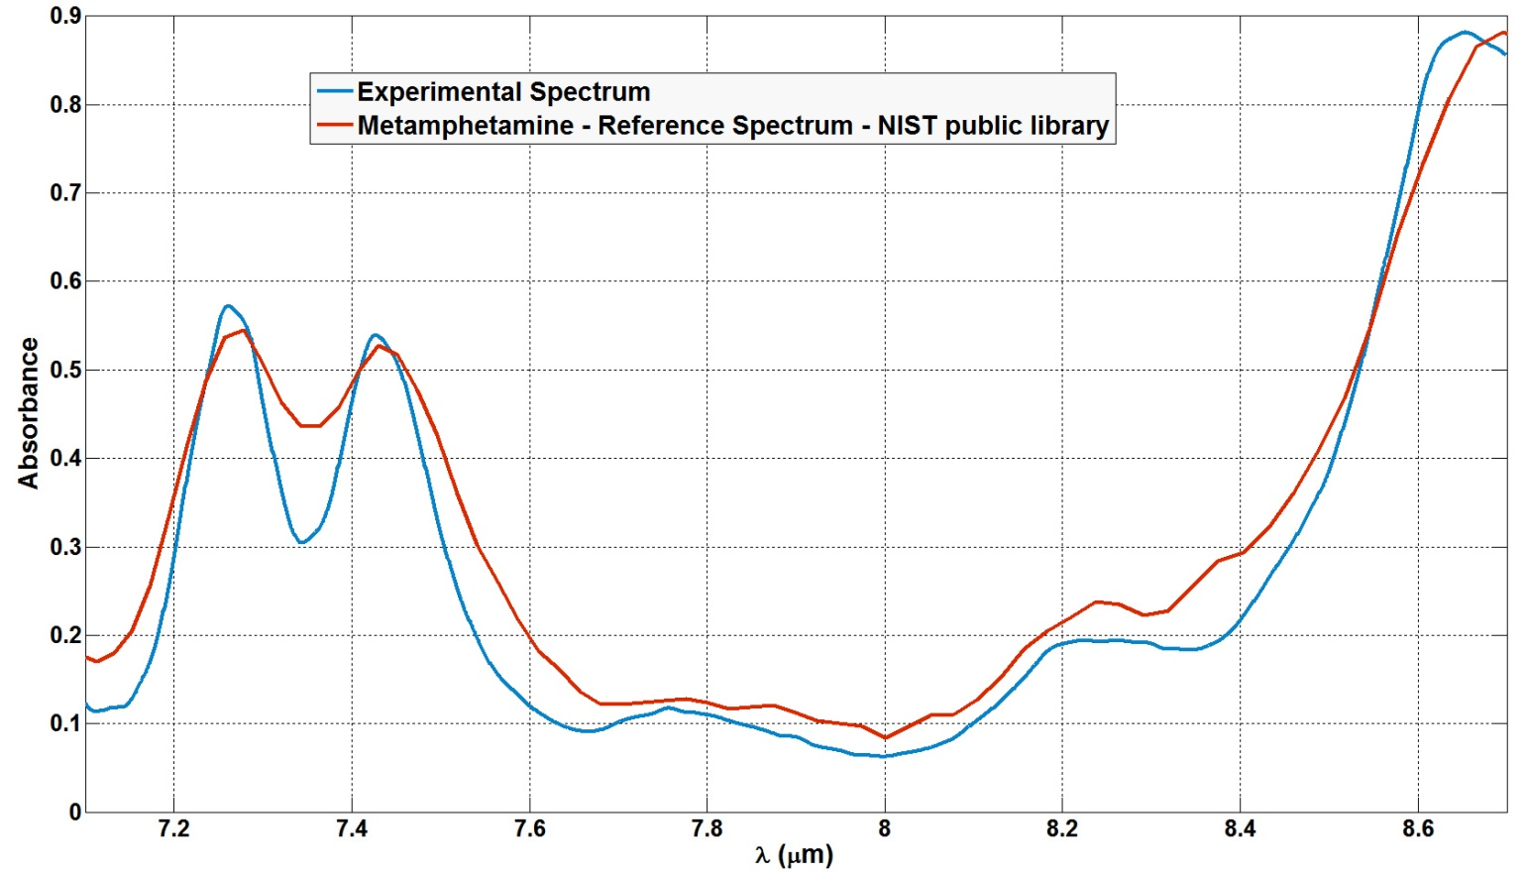
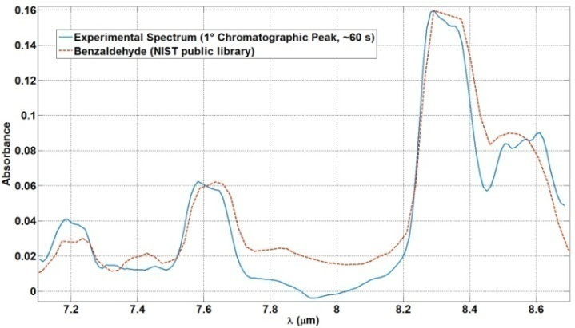
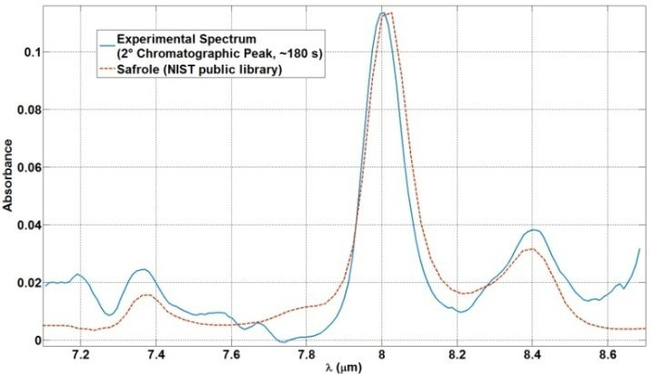
Rapid screening and identification of illegal Drugs by IR Absorption spectroscopy and gas Chromatography
CREO - Centro Ricerche Elettro Ottiche, SS 17 Località Boschetto L'Aquila (Italy) - sandro.mengali@consorziocreo.it
Selex ES,ViaTiburtina Km.12,400, 00131 Roma (Italy)
CNR-IMM Sezione di Bologna, Via P.Gobetti 10, 40129 Bologna (Italy)
Università di Parma (Dip. di Chimica Organica e Industriale), and INSTM UdR Parma, Viale G. P. Usberti 17 A, I-43100 Parma (Italy)
Universitatea Dunarea de Jos Galati, Str. Domnească, nr. 47, 800008 Galaţi (Romania)
NBI - National Bureau of Investigation, Jokiniemenkuja 4, PO Box 2 85, FI-01301 Vantaa (Finland )
EADS Innovation Works , D-81663 München, (Germany)
University of Lausanne, CH-1015 Lausanne (Switzerland)
NICC - Nationaal Instituut voor Criminalistiek en Criminologie, Chaussée de Vilvorde 100, B-1120 Bruxelles (Belgium)
This advanced sensor system combines miniaturized Gas Chromatography (GC) as its key chemical separation tool, and Hollow-Fiber-based Infra Red Absorption Spectroscopy (HF-IRAS) as its key analytical tool, to recognize and detect illicit drugs, key precursors and potential derivatives. The DIRAC sensor was developed to be used on the field primarily by Customs for controls at the EU borders, and by law enforcement personnel for intra-Community checks, as a rugged and hand-portable unit. The sensor performs rapid detection of key chemicals, with trace sensitivity and high specificity. Compared to other sensors available on the market, it shows superior classification ability and resilience to contamination.
Application Scenarios
Test vehicle
While GC-IRAS is, together with GC-Mass Spectrometry, the most powerful technique for the identification and quantification of amphetamines, so far it has been implemented only as bench-top instrumentation for forensic applications and bulk analysis.
In DIRAC sensor, the use of micro-machined GC columns, solid state lasers, and IR hollow fibers, allows to implement a sensor that features hand-portability and prompt response for field operation, and is capable to perform both bulk and trace analysis.
– Goods control at customs:
Particles collected on a swab from the envelope;
– Screening of cargo containers:
Pre-concentration and analysis of vapours in the air;
– Police applications at clan labs:
On-site analysis of waste and products
Fumes from a suspected location
The DIRAC sensor further features: (a) an advanced micro-machined vapour pre-concentrator, (b) a customized Human-Machine-Interface and (c) a chemometric based expert system.
Final Demo:
Will be held on March 20, 2014, at the Customs of the Brussels National Airport
The DIRAC sensor has been shown capable of analyzing ATS and precursors, as pure compounds and mixtures, by sampling vapours from the air or thermally desorbing solids and liquids, water or organic solutions.
Tests & Results
APAAN
(3-oxo-2-fenylbutaannitril)
Methamphetamine Hydrochloride
Mixture: Benzaldehyde + Safrole (1:2)
Limits of Detection are currently around 10 ng for many precursors (without amine groups), and one order of magnitude larger for amine precursors and ATS.
1° Chromatographic Peak:
Benzaldehyde
2° Chromatographic Peak:
Safrole
Substance | Injected Mass (ng) | λ_{Peak} (μm) | Peak Absorbance | Noise | LoD
Safrole | ~ 100 | 8.02 | 0.044 | 0.0057 | 12.9 ng
Piperonal | ~ 400 | 7.97 | 0.140 | 0.029 | 8.4 ng
Ephedrine | ~ 5 | 8.36 | 0.067 | 0.00058 | 130 ng
Acknowledgements
This work has been carried out within the FP7 research projects DIRAC ("rapid screening and identification of illegal Drugs by IR Absorption spectroscopy and gas Chromatography"), funded by the EU (Grant agreement no. 242309).

